Slide 1
Python Object Oriented
Università di Modena e Reggio Emilia
Prof. Nicola Bicocchi (nicola.bicocchi@unimore.it)

Slide 2

Class
Descriptor of a class of objects (Platonic idea)

Slide 3
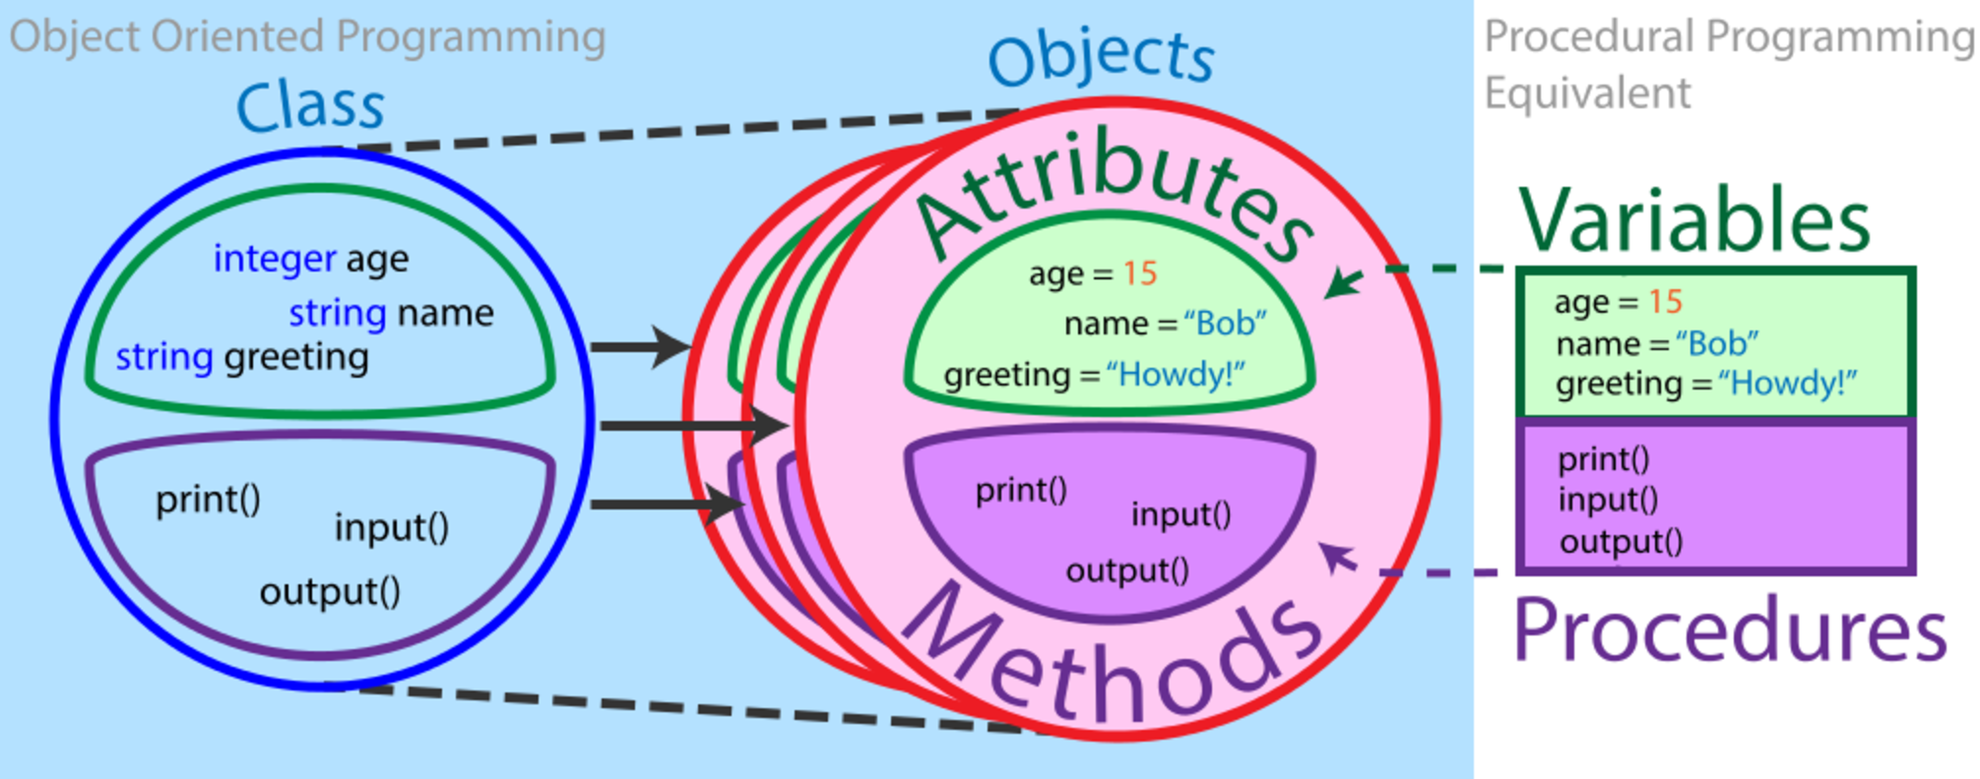
Class

Slide 4
Class Definition
class Car:
# method
def __init__(self, brand, model):
# instance attributes
self.brand = brand
self.model = model
if __name__ == '__main__':
m3 = Car('Bmw', 'M3')
tsla = Car('Tesla', 'Roadster’)
print("Brand={}, Model={}".format(m3.brand, m3.model))
print("Brand={}, Model={}".format(tsla.brand, tsla.model))
# Output
Brand=Bmw, Model=M3
Brand=Tesla, Model=Roadster

Slide 5
Class Definition
class Car:
# class attribute
wheels = 4
def __init__(self, brand, model):
self.brand = brand
self.model = model
if __name__ == '__main__':
m3 = Car('Bmw', 'M3')
tsla = Car('Tesla', 'Roadster')
print("Wheels={}".format(m3.__class__.wheels))
print("{}, {}".format(m3.brand, m3.model))
print("Wheels={}".format(tsla.__class__.wheels))
print("{},{}".format(tsla.brand, tsla.model))
# Output
Wheels=4
Brand=Bmw, Model=M3
Wheels=4
Brand=Tesla, Model=Roadster
Attributes are defined inside the __init__ method of the class. It is the initializer method (frequently called constructor) that is first run as soon as the object is created.
Then, we create instances of the Car class. m3 and tsla are references to our new objects.
We can access the class attribute using __class__.species. Class attributes are the same for all instances of a class.
Similarly, we access the instance attributes using m3.brand or tsla.model. Instance attributes are different for every instance of a class.

Slide 6
Constructors
Constructor method contains operations we want to execute as soon as objects are created (attributes initialization!)
__init__ is a reseved method in python classes. It is called as a constructor in object oriented terminology. This method is called when an object is created from a class and it allows the class to initialize the attributes of the class.

